Slide 1
Team Members:
UTKARSH PANKAJ - 2420090138
SURA DHANUSH - 2420090083
RITHISH RAO - 2420030778
SECURE DEVICE REGISTRATION & INTELLIGENT ACCESS CONTROL SYSTEM
Review-2

Slide 2
PROJECT OVERVIEW & REVIEW 2 FOCUS
Project Motivation
Project Scope
Modern networks face uncontrolled device onboarding and static access policies that fail against dynamic, evolving cyber threats.
End-to-end secure device registration, fingerprinting, risk scoring, and intelligent access control across heterogeneous network environments.
Problem Statement
Core Objectives
Existing access control systems lack adaptive intelligence, real-time device trust evaluation, and automated policy enforcement based on contextual risk.
Design and implement a SOA-based system for device fingerprinting, dynamic risk scoring, and policy-driven access decisions with full audit logging.
Review 1 Progress
Review 2 Focus
Completed system architecture design, SOA service decomposition, database schema, and prototype device registration and fingerprinting modules.
Dynamic risk scoring engine, access-decision microservice, API integration, end-to-end testing, and security history monitoring dashboard.
Key Differentiators
Expected Outcomes
Combines behavioral fingerprinting, ML-assisted anomaly detection, and real-time adaptive policy enforcement within a modular microservices architecture.
A fully operational, testable system with documented APIs, risk scoring logic, access control enforcement, and a Grafana-based monitoring dashboard.

Slide 3

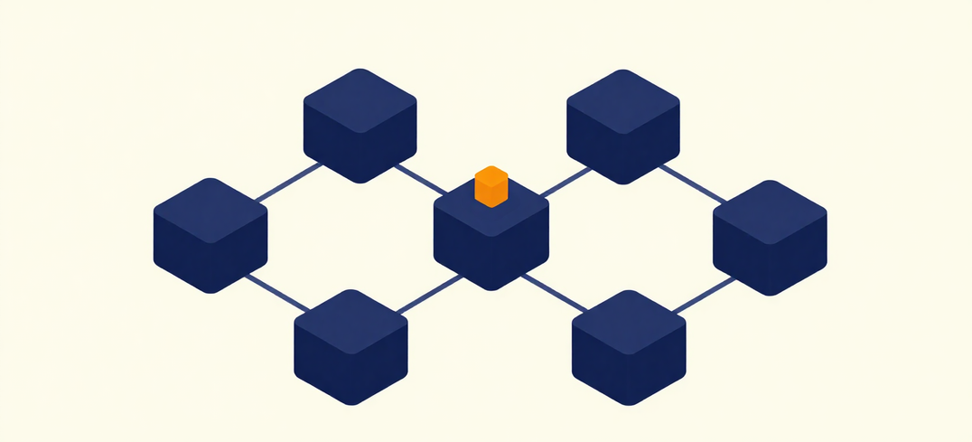
SYSTEM ARCHITECTURE
& SOA SERVICES
Client / Device Layer
Service Layer (SOA)
The client/device layer encompasses all endpoint devices initiating access requests. Each device submits registration credentials, hardware fingerprint data, and behavioral signals. Communication flows through a secure API gateway using TLS-encrypted channels. Devices are classified by type, trust level, and registration status before any access decision is made. Unregistered or anomalous devices are quarantined automatically.
The SOA service layer comprises six loosely coupled microservices: (1) Registration Service — onboards and validates new devices; (2) Fingerprinting Service — extracts and stores hardware/behavioral signatures; (3) Risk Assessment Service — computes dynamic risk scores using ML models; (4) Policy Engine — enforces Allow/Monitor/Rate-Limit/Block decisions; (5) Authentication Service — manages token issuance and session integrity; (6) Audit Service — logs all events to PostgreSQL for forensic review.

Slide 4
METHODOLOGY &
ACCESS-DECISION FLOW
Step 1 – Device/Request Submission:
Step 2 – Identity & Fingerprint Verification:
A device initiates a connection request to the gateway; the request payload includes device ID, timestamp, and network metadata. The submission layer normalises and forwards the request to the verification pipeline for processing.
The identity service validates device credentials against the registration store; the fingerprinting module cross-checks hardware and behavioural fingerprints to detect spoofing, cloning, or credential misuse attempts.
Step 3 – Dynamic Risk Scoring:
Step 4 – Allow / Challenge / Deny Decision:
The Risk Engine aggregates identity confidence, fingerprint match score, anomaly signals, and historical behaviour into a real-time numeric risk score (0–100), updated continuously per session event.
The Decision Engine maps the risk score to a policy action: Allow (low risk), Challenge via MFA (medium risk), or Deny and isolate (high risk). All decisions are logged to PostgreSQL for audit and adaptive policy feedback.

Slide 5
DEVICE REGISTRATION & FINGERPRINTING
Registration Workflow
Fingerprint Attributes
Duplicate Detection
New devices initiate registration via a secure REST endpoint. The system collects device metadata, validates the request origin, and issues a provisional identity token pending full fingerprint verification and admin approval.
Device fingerprints are derived from MAC address, OS type, browser/agent string, screen resolution, timezone, and IP subnet. These attributes are hashed into a stable fingerprint vector stored for future comparison.
Incoming fingerprints are compared against the registered device store using cosine similarity scoring. Devices exceeding a match threshold are flagged as duplicates, triggering alerts and blocking redundant registration attempts.
Identity Binding
Credential Handling
Secure Storage
Each registered device is cryptographically bound to a user identity. A unique device-user pair record is stored in PostgreSQL, linking the hardware fingerprint to authenticated credentials for persistent session validation.
Device credentials are salted and hashed using bcrypt before storage. JWT tokens with short expiry are issued upon successful registration. Refresh tokens are rotated on each use to prevent replay attacks.
All device records are persisted in PostgreSQL with AES-256 encryption at rest. Redis caches active device sessions for low-latency lookups. Audit logs capture every registration event for forensic traceability.

Slide 6
DYNAMIC RISK SCORING
Risk Signals & Inputs
Contextual Input Factors
Risk signals are derived from device fingerprint anomalies, geolocation shifts, failed authentication attempts, unusual access times, and behavioral deviations from historical baselines.
Contextual inputs include network type (trusted/untrusted), time-of-day patterns, user role sensitivity, session duration, and concurrent session detection across devices.
Scoring Rules & Weights
Trust Threshold Levels
Each risk factor carries a weighted score. Scores are aggregated using a normalized formula, with critical signals such as fingerprint mismatch or geo-impossible travel applying multiplicative penalties.
Trust thresholds are defined across four tiers: Low Risk (0–25), Moderate Risk (26–50), High Risk (51–75), and Critical Risk (76–100), each mapped to a specific enforcement policy.
Adaptive Response Actions
Continuous Reassessment
nftables enforces adaptive responses per tier: full access (Low), step-up MFA challenge (Moderate), rate-limit and alert (High), and immediate session block with incident logging (Critical).
Risk scores are not static — they are recalculated at configurable intervals during active sessions, allowing the system to elevate or reduce enforcement levels as context evolves in real time.
Score Persistence & Audit
ML-Enhanced Scoring
All computed risk scores, contributing signals, and triggered actions are persisted in PostgreSQL for audit trails, enabling retrospective analysis and ML model retraining over time.
An ML-based anomaly detection layer supplements rule-based scoring by identifying subtle behavioral patterns that static rules may miss, improving detection accuracy for zero-day threats.

Slide 7
SOA & MICROSERVICES
IMPLEMENTATION
API Gateway Service
Fingerprint Service
Access-Control Service
A centralized API Gateway handles all inbound requests, enforcing authentication, rate limiting, and routing. It acts as the single entry point across all microservices, abstracting internal topology from clients.
An isolated microservice extracts and normalizes device fingerprint attributes — hardware identifiers, OS metadata, and behavioral signals — and exposes a scoring API consumed by the Risk Engine downstream.
The Access-Control Service subscribes to risk score events and enforces policy decisions — allow, challenge, rate-limit, or block — by updating nftables rules and issuing access tokens with appropriate privilege scopes.
Registration Service
Risk Engine Service
Audit & Logging Service
The Registration Service manages the full device onboarding lifecycle — accepting enrollment requests, validating device credentials, persisting device records, and issuing signed registration tokens via a REST interface.
The Risk Engine service aggregates fingerprint scores, anomaly signals, and session history to compute a dynamic risk score per device. It publishes scored events to an internal message bus for downstream consumers.
A dedicated Audit Service captures structured logs from all service interactions, storing immutable event records in PostgreSQL. Grafana dashboards provide real-time observability across service boundaries and access decisions.

Slide 8
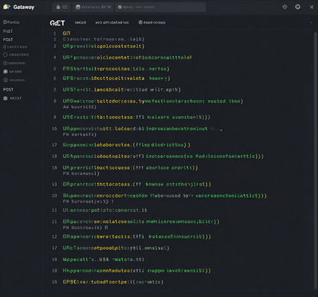
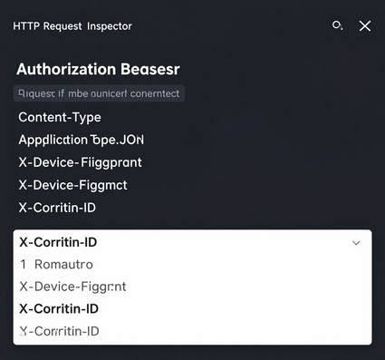
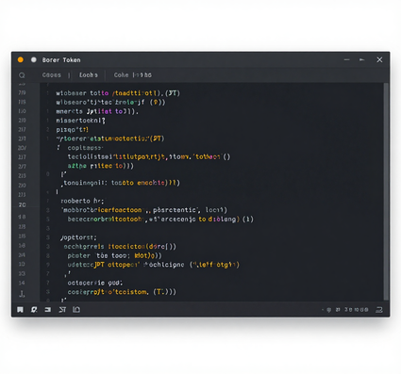
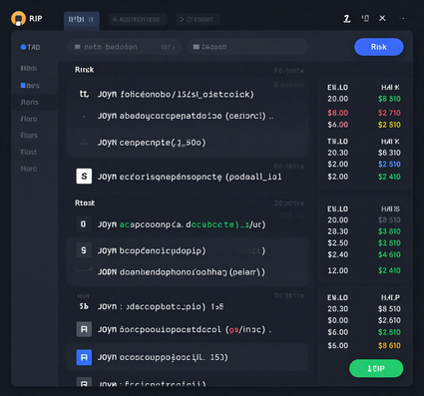
API COMMUNICATION & DATA FLOW
API Gateway Routes
Request Headers
  REST Request Flow: Client sends authenticated requests via API Gateway with JWT bearer tokens and device fingerprint headers for identity verification.
  Service-to-Service: Gateway routes to Auth, Risk, and Registration microservices using internal REST calls with signed payloads and correlation IDs.
  Response Outcomes: Services return structured JSON responses including access decisions, risk scores, and session tokens back through the gateway to the client.
Auth Token Flow
Service Response

Slide 9

IMPLEMENTATION & TESTING EVIDENCE
Implemented Modules: Device registration pipeline (fingerprint capture → hash generation → registry storage), risk scoring engine, and nftables-based access enforcement are operational.
Test Scenarios & Results:
• Unit tests: Fingerprint extraction and hash consistency verified across 10 device profiles
• Integration test: End-to-end registration flow validated — device enrolled, risk score computed, access granted/denied correctly
• Risk Score Output: Scores ranging 0–100 generated based on IP reputation, port anomalies, and behavioral flags
• Access Decision Logs: ALLOW/BLOCK decisions logged with timestamp, device ID, and risk threshold breach details
• Screenshot Placeholders: Dashboard views of Prometheus metrics and Grafana alert panels (to be attached)
• Known Limitations: ML model accuracy limited by training dataset size; dynamic re-registration on IP change not yet fully automated

Slide 10

GITHUB REPOSITORY & DOCUMENTATION
Repository & Documentation Status:
All project artifacts are organized and hosted on GitHub for reproducibility and peer review.
• README with project overview, setup instructions, and architecture summary
• Architecture diagrams: SOA service map, data flow, and risk scoring pipeline
• API documentation: endpoint specifications, request/response schemas, and authentication flows
• Setup instructions: Docker Compose, dependency installation, and environment configuration
• Commit history as evidence of iterative development and milestone progress
• Proposed future work: federated learning integration, cross-platform device support, and formal security audit

